Slide 1
Music Genre Classification and Statistics
By Brandon Rasgaitis, Julien Toulon, Lucie Gaye, Tyler Desharnais

Slide 2
Summary
Introduction
How does music genre classification work?
Application
Model
Code for data collection
Our roles and tasks
Current obstacles
Our solutions

Slide 3

Introduction: what is MGC?

Slide 4
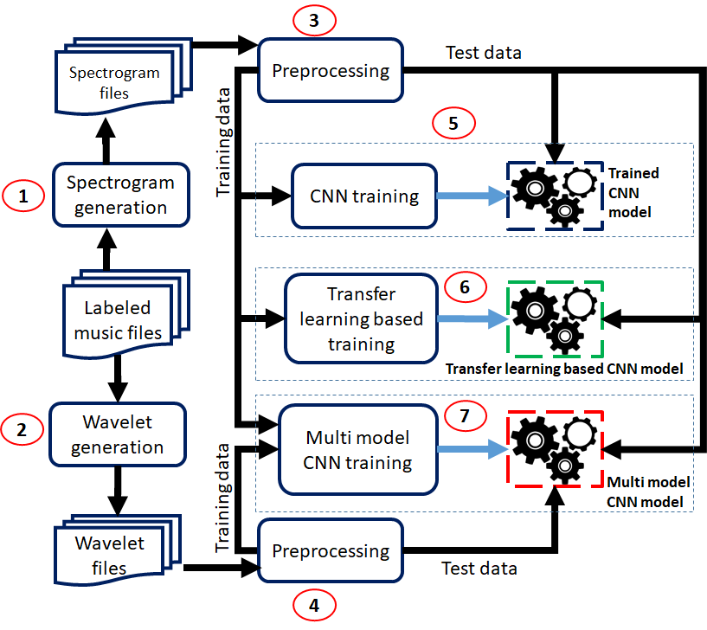
How does MGC work?

Slide 5
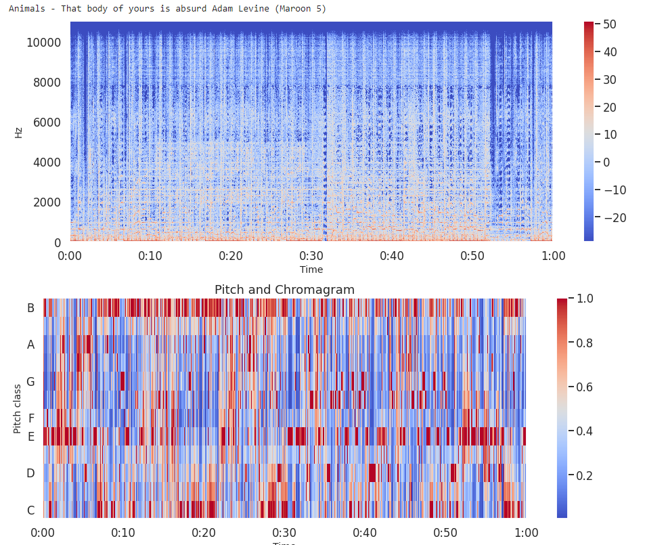
Application
Classify music with their spectrograms
Improve the projects which already exists
Help artists to analyze the best commercial success with a lot of datas.

Slide 6
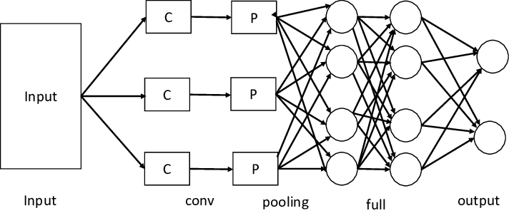
Model
Dataset: 20 000 songs and their spectrograms from the top charts
Type: Convolutional Neural Network, LSTM and classical

Slide 7
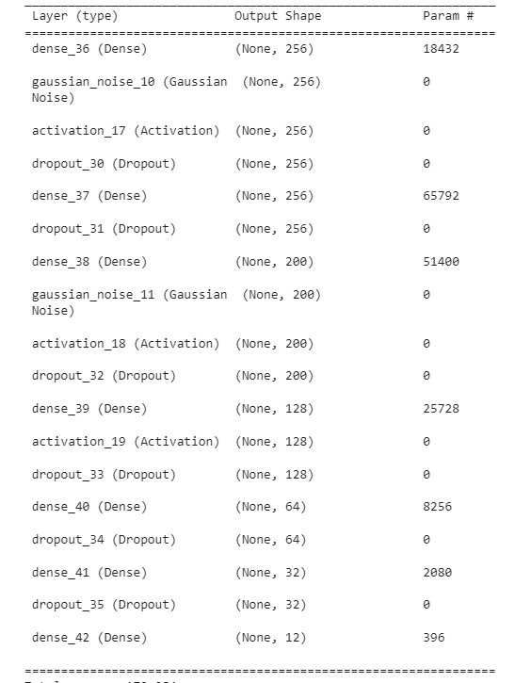
Model
The CNN model will be used for the extraction of the mel spectrograms.
To the right is a normal MLP model used for testing before adding the mel spectrograms and MFCC arrays

Slide 8
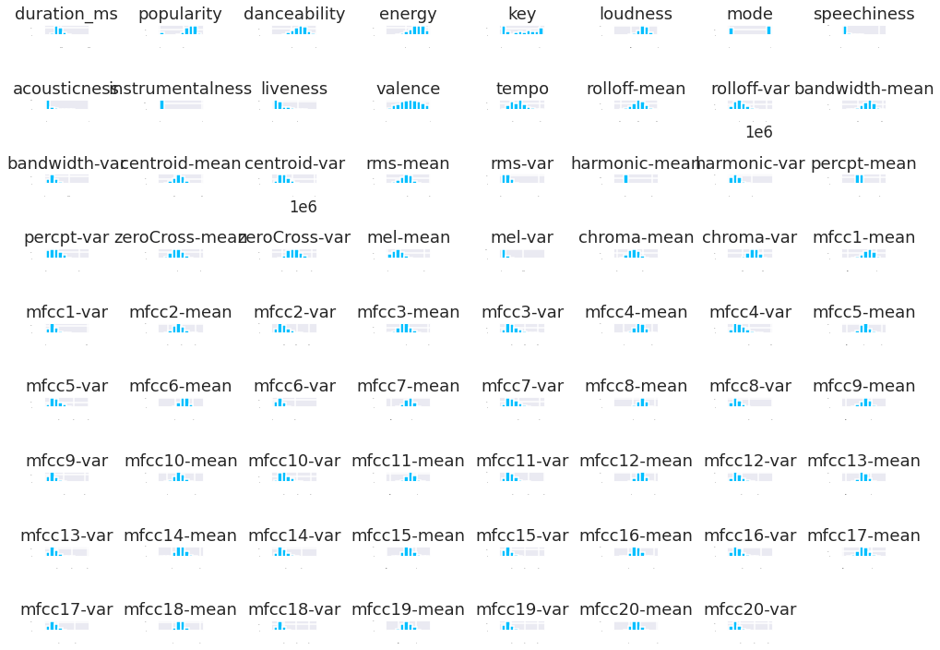
Code for Data Collection
Example of data exploration:
df.hist(xlabelsize=1,ylabelsize=1)
plt.tight_layout()
Tyler's Code

Slide 9
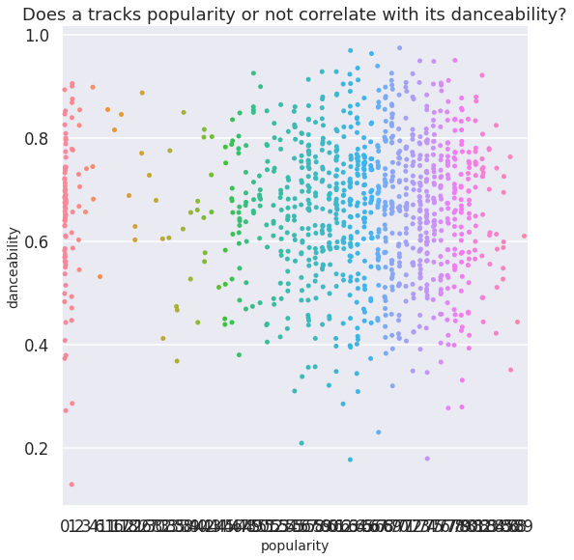
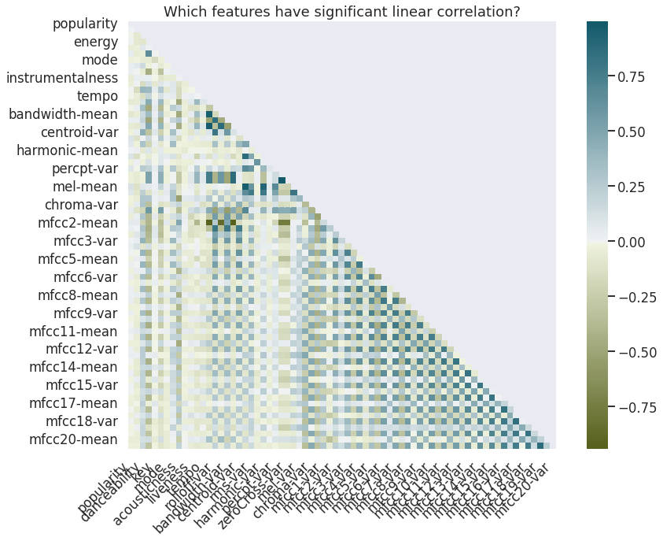
Is there a correlation between popularity and danceability?

Slide 10
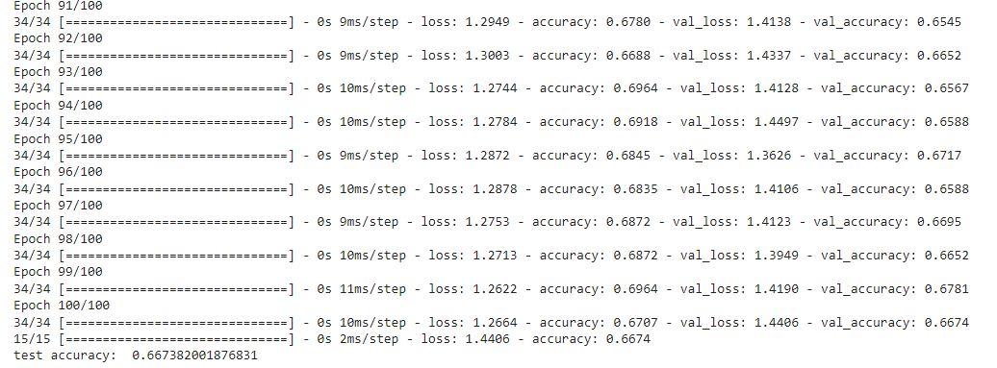
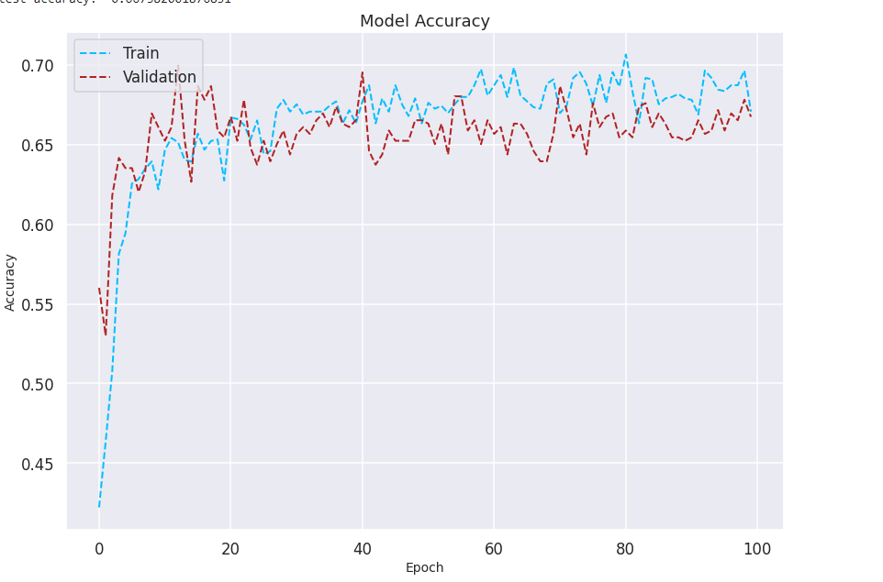
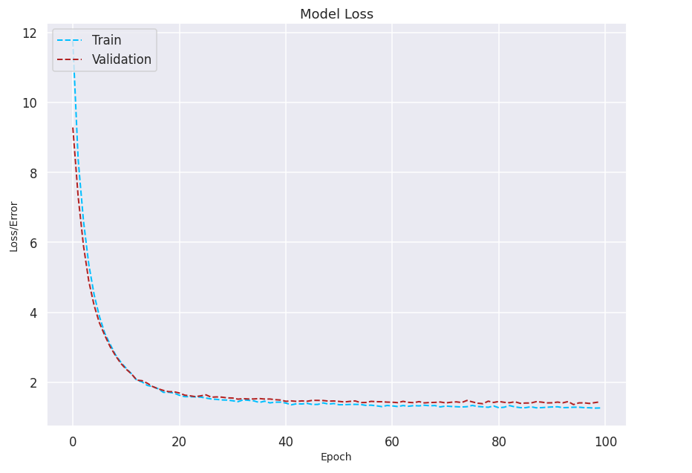
The results of the code

Slide 11
Roles and Tasks
*Brandon
-CNN model creation
-Accuracy testing
-validation data testing
-False Negative Testing
*Lucie
-Accuracy Testing
-Labeling of Spectrogram images to the appropriate songs
- False Positive testing
*Tyler
-collect/produce data for model
-spectrogram data generation
-Accuracy Testing
*Julien
-Training of data set
-Accuracy Testing
-Histogram/ROC-AUC creation
-

Slide 12
Current Status
Data collection
Our dataset includes 20,000 songs.
Per 20,000 songs a spectrogram image of the song is created
CNN Model
Using the CNN created in HW2 to classify and label the spectrogram images
So far label accuracy is only correct ⅙ of the time.

Slide 13
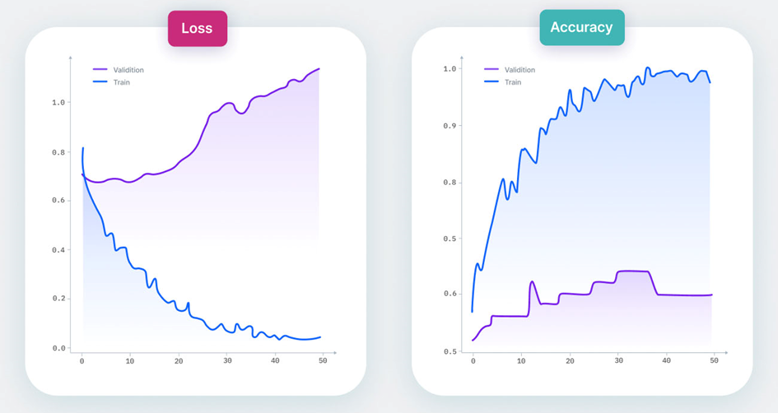
Current Obstacles: Overfitting of dataset and Accuracy
Signs of overfitting

Slide 14
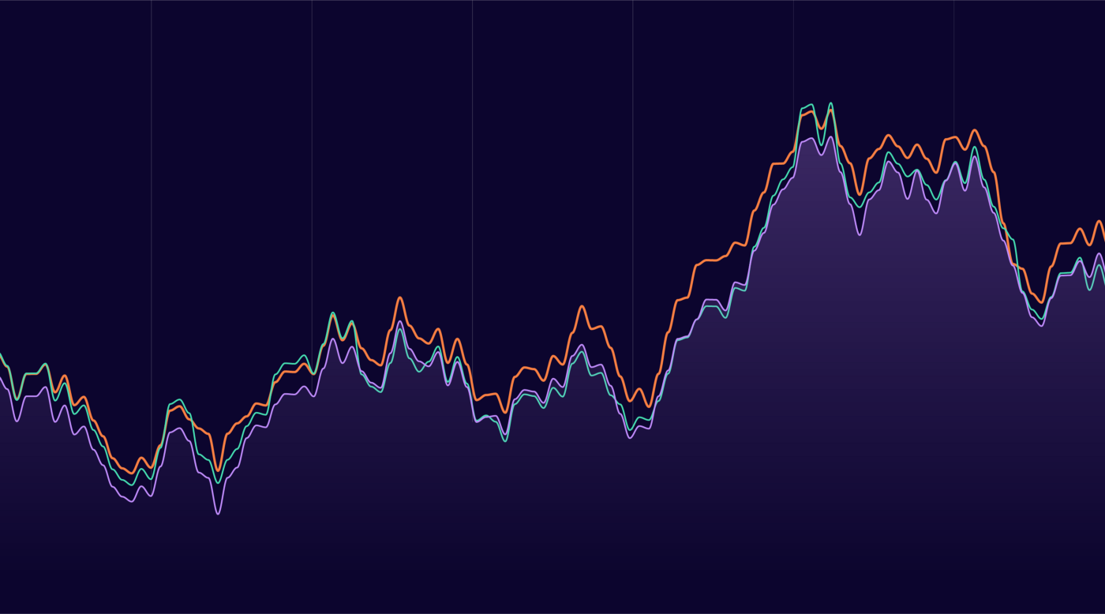
Current Obstacles: Time needed to generate dataset

Slide 15

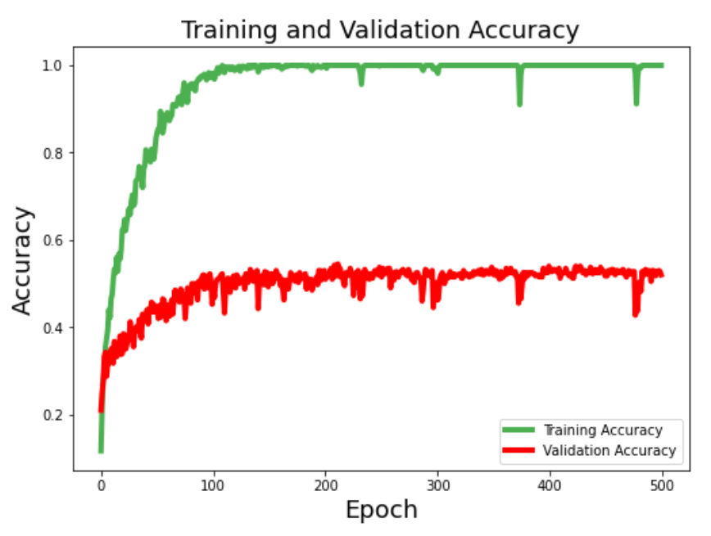
Current Obstacles: Model accuracy

Slide 16
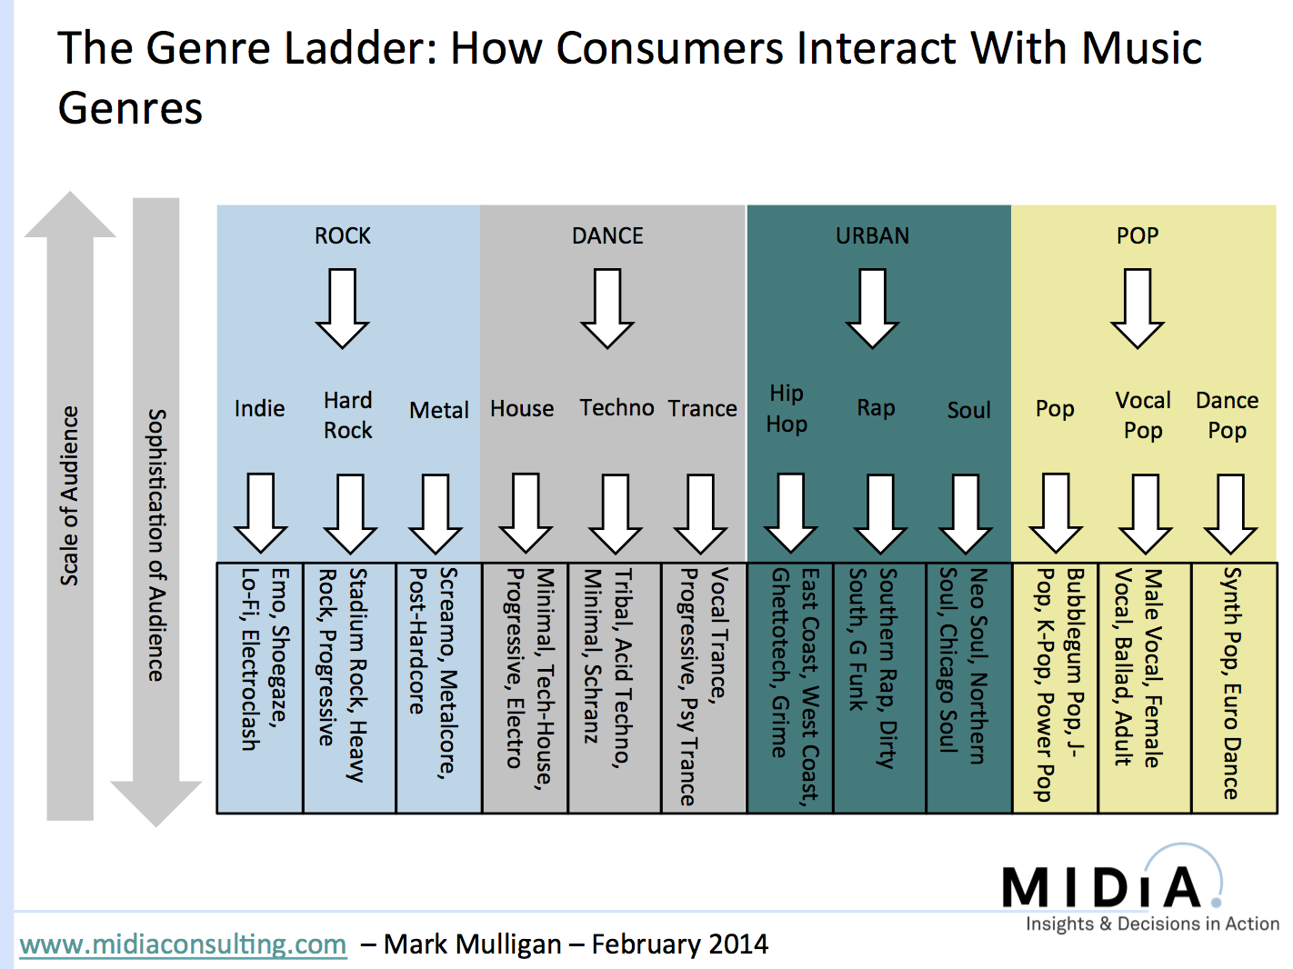
Current Obstacles: change of trend

Slide 17
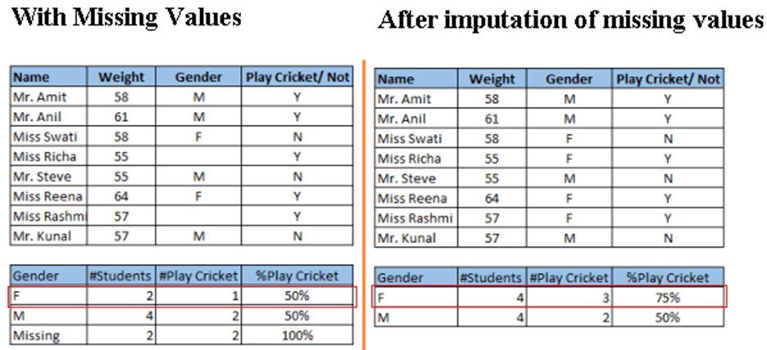
Conclusion (eventual solutions for obstacles)
Data augmentation
Addition of noise to the input data
Cross-validation
Simplify data
Regularization
Ensembling
using synthetic data
Add more data
Treat missing and Outlier values
Feature Engineering
Feature Selection
Multiple algorithms
Algorithm Tuning

Slide 18
Sources
Images:
https://www.analyticsvidhya.com/blog/2022/03/music-genre-classification-project-using-machine-learning-techniques/
https://editor.analyticsvidhya.com/uploads/97515flow.png
https://assets-global.website-files.com/5d7b77b063a9066d83e1209c/62d92c8c0b694cae05d48137_Signs%20of%20overfitting.jpg
https://miro.medium.com/max/1400/1*Y5e9JcKti8LYQXTK8_JsIw@2x.png
https://www.google.com/url?sa=i&url=https%3A%2F%2Ftowardsdatascience.com
Websites:
https://www.analyticsvidhya.com/blog/2022/03/music-genre-classification-project-using-machine-learning-techniques/
https://www.kdnuggets.com/2022/03/synthetic-data-overcome-data-shortages-machine-learning-model-training.html
https://www.analyticsvidhya.com/blog/2015/12/improve-machine-learning-results/

